Slide 1

Systems Analysis and Design in a Changing World, Fourth Edition

Slide 2
Understanding the Elements of Design
Design is process of describing, organizing, and structuring system components at architectural design level and detailed design level
  Focused on preparing for construction
  Like developing blueprints
Two questions:
  What components require systems design?
  What are inputs to and outputs of design process?
Systems Analysis and Design in a Changing World, 4th Edition

Slide 3
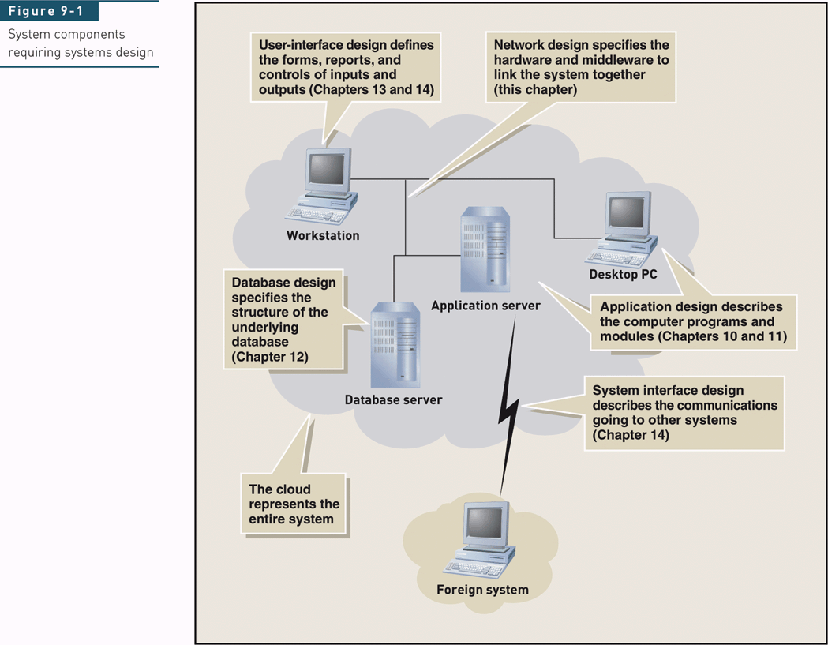
Components Requiring Systems Design
Systems Analysis and Design in a Changing World, 4th Edition

Slide 4
Moving from Analysis to Design
Design
  Converts functional models from analysis into models that represent the solution
  Focused on technical issues
  Requires less user involvement than analysis
Design may use structured or OO approaches
  Database can be relational, OO, or hybrid
  User interface issues
Systems Analysis and Design in a Changing World, 4th Edition

Slide 5
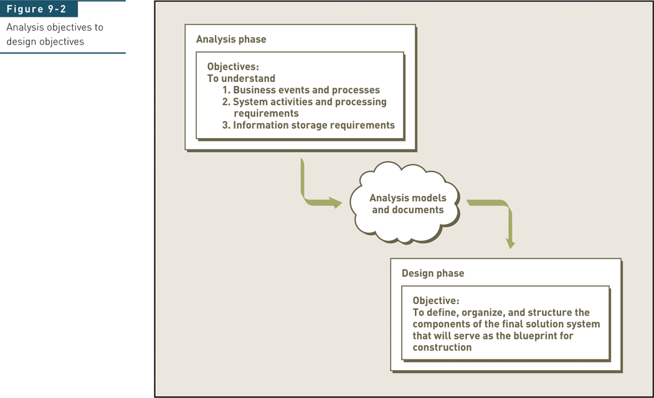
Analysis Objectives to Design Objectives
Systems Analysis and Design in a Changing World, 4th Edition

Slide 6
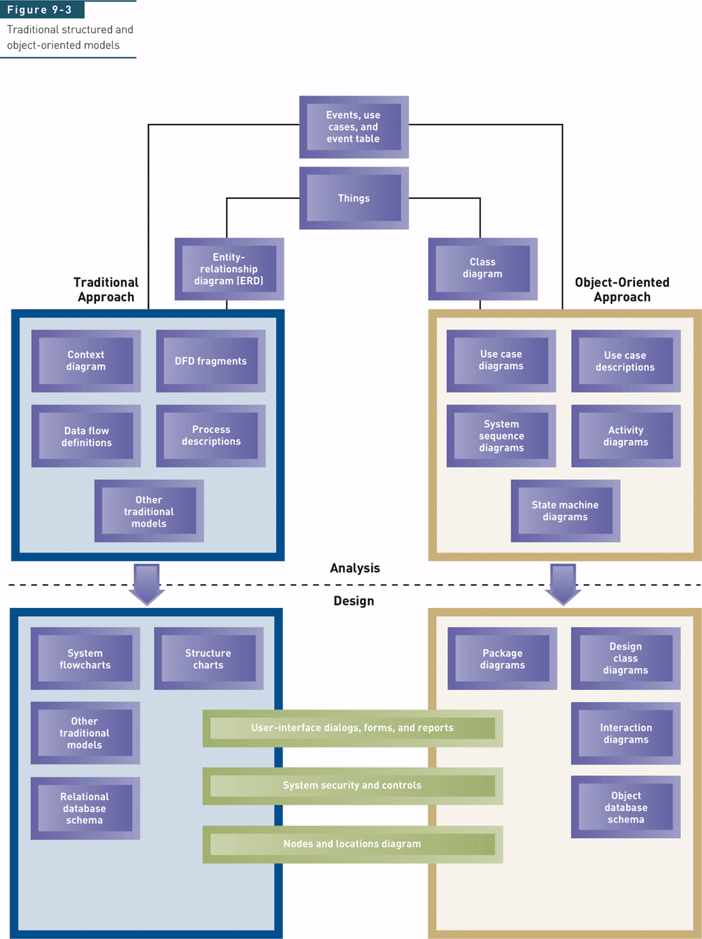
Traditional Structured and Object-Oriented Models
(Figure 9-3)
Systems Analysis and Design in a Changing World, 4th Edition

Slide 7
Traditional structured & Object-oriented models
Structured Techniques:
  To describe the structure and organization of the system written using input-process-output-model of software ( Suitable for business applications that relay on database and files which do not required a real time processing).
Object– Oriented Techniques:
  They are well suited to real time and interactive software that required multitasking capabilities(eg. Operating systems).
Question: Can two techniques be mixed?
Systems Analysis and Design in a Changing World, 4th Edition

Slide 8
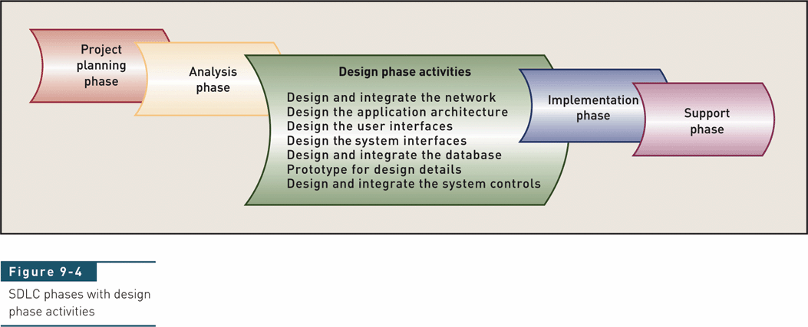
SDLC Phases with Design Phase Activities
Systems Analysis and Design in a Changing World, 4th Edition

Slide 9
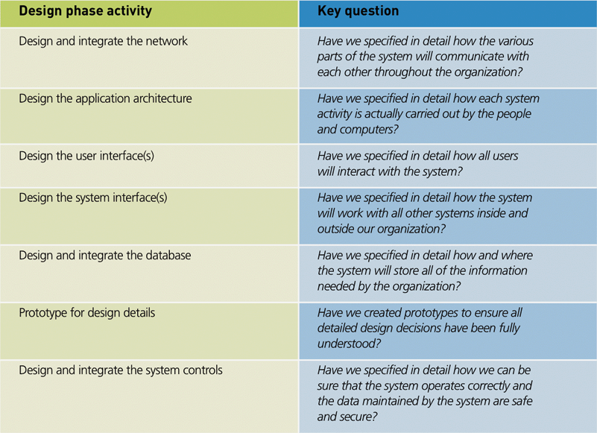
Design Phase Activities and Key Questions
(Figure 9-5)
Systems Analysis and Design in a Changing World, 4th Edition

Slide 10
Design and Integrate the Network
Network specialists establish network based on strategic plan
Project team typically integrates system into existing network
Technical requirements have to do with communication via networks
Technical issues handled by network specialists
  Reliability, security, throughput, synchronization
Systems Analysis and Design in a Changing World, 4th Edition

Slide 11
Design the Application Architecture
Specify how system use cases are carried out
Described during system analysis as logical models of system activities
After design alternative is selected, detailed computer processing is designed as physical models, such as physical data flow diagrams and structure charts (traditional) or interaction diagrams and class diagrams (OO).
Define the automation boundary.
Approach varies depending on development and deployment environments
Systems Analysis and Design in a Changing World, 4th Edition

Slide 12
Design the User Interfaces
User interface quality is critical aspect of system
Design of user interface defines how user interacts with system
  GUI – windows, dialog boxes, mouse interaction
  Sound, video, voice commands
To user of system, user interface is the system
User interface specialists – interface designers, usability consultants, human factors engineers
Systems Analysis and Design in a Changing World, 4th Edition

Slide 13
Design the System Interfaces
System interfaces enable systems to share and exchange information
  Internal organization systems
  Interfaces with systems outside organization
  New system interfaces with package application that organization has purchased and installed
System interfaces can be complex
Organization needs very specialized technical skills to work on these interfaces
Systems Analysis and Design in a Changing World, 4th Edition

Slide 14
Design and Integrate the Database
System analysis data model used to create physical database model
Collection of traditional computer files, relational databases, and/or object-oriented databases
Technical requirements, such as response times, determine database performance needs
Design work might involve
  Performance tuning
  Integration between new and existing databases
Systems Analysis and Design in a Changing World, 4th Edition

Slide 15
Prototype for Design Details
The basic idea of a prototype is to test some new or risky aspect of the new system before committing major resources to a particular configuration of the new solution
Prototypes confirm design choices
  Database
  Network architecture
  Controls
  Programming environment
Systems Analysis and Design in a Changing World, 4th Edition

Slide 16
Design and Integrate the System Controls
Final design activity to ensure system has enough safeguards (system controls) to protect organizational assets
Controls are needed for all other design activities
  User interface – limit access to authorized users
  System interface – protect from other systems
  Application architecture – record transactions
  Database – protect from software/hardware failure
  Network design – protect communications
Systems Analysis and Design in a Changing World, 4th Edition

Slide 17
Project Management —Coordinating the Project
Manage changing requirements
Coordinate design elements
Coordinate project teams
  Project schedule - coordinate ongoing work
Coordinate information
  CASE tools and central repository
  Team communication and information coordination
  Track open items and unresolved issues
Systems Analysis and Design in a Changing World, 4th Edition

Slide 18
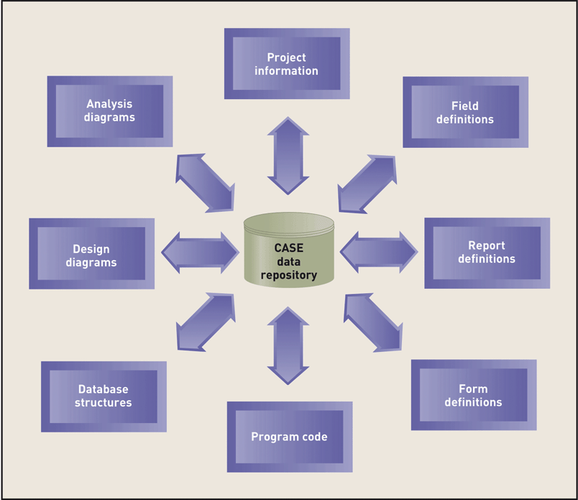
System Development Information Stored in the CASE Repository (Figure 9-6)
Systems Analysis and Design in a Changing World, 4th Edition

Slide 19
Deployment Environment
Deployment environment definition bridges analysis and design
  Hardware
  System software
  Networking
Common deployment environments in which system will operate
Related design patterns and architectures for application software
Systems Analysis and Design in a Changing World, 4th Edition

Slide 20
Single-Computer and Multitier Architecture
Single-computer architecture
  Mainframe-based
  Limited by single machine capacity ( impractical or unusable for large information systems).
  Requires all system users to be located near the computer.
  Simplicity is one of the primary advantage.
  Information systems deployed on it are relatively easy to design, build, operate and maintain.
Systems Analysis and Design in a Changing World, 4th Edition

Slide 21
Single-Computer and Multitier Architecture
Multitier architecture:
  Employs multiple computer system in a cooperate effort to meet information-processing needs.
Clustered and multi-computer architecture:
  Group of computers of the same type that share processing and data storage capacity ( load can be balanced ).
  Cluster acts as a single system
  Multicomputer hardware/OS can be less similar than clustered
Systems Analysis and Design in a Changing World, 4th Edition

Slide 22
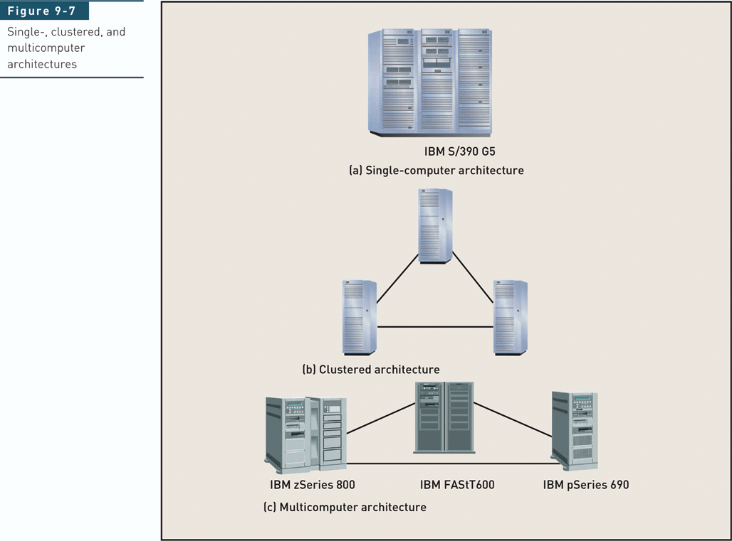
Single-, Clustered, and
Multicomputer Architectures
Systems Analysis and Design in a Changing World, 4th Edition

Slide 23
Centralized and Distributed Architecture
Centralized Architecture:
  Locates all computing resources in a central location including large-scale processing applications, including both batch and real-time applications ( eg: Banking, insurance and catalog sales.
Systems Analysis and Design in a Changing World, 4th Edition

Slide 24
Centralized and Distributed Architecture (cont.)
Distributed Architecture:
Components of a modern information system are typically distributed across many computer systems and geographic location. across several computers and locations ( eg. Corporate financial departments)
Relies on communication networks for geographic connectivity
Client/server architecture dominant model for distributed computing
Systems Analysis and Design in a Changing World, 4th Edition

Slide 25
Computer Network
Set of transmission lines, specialized hardware, and communication protocols
Enables communication among different users and computer systems
Local area network (LAN) less than one kilometer long – connects computers within single building
Wide area network (WAN) over one kilometer long – implies much greater, global, distances
Router : connect each LAN to the WAN and directs information within network
Systems Analysis and Design in a Changing World, 4th Edition

Slide 26
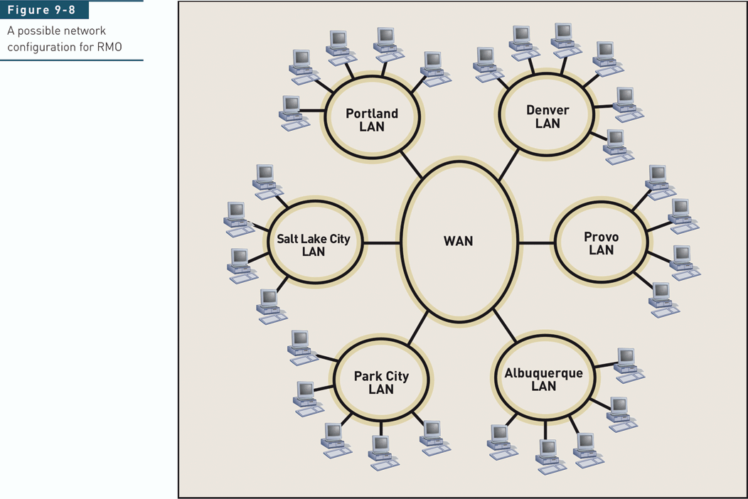
A Possible Network Configuration for RMO
Systems Analysis and Design in a Changing World, 4th Edition

Slide 27
The Internet, Intranets, and Extranets
Internet :
  Global collection of networks that use TCP/IP networking protocols.
  World Wide Web (WWW): is a collection of resources ( programs, files, and services).
  Can be accessed over the internet by a number of standard protocols, including the following:
    Formatted and linked document protocols (HTML, HTTP)
    Executable program standards ( Java, JavaScript)
Systems Analysis and Design in a Changing World, 4th Edition

Slide 28
The Internet, Intranets, and Extranets (Cont.)
Intranets
  Private networks using same TCP/IP protocols as the Internet
  Limited to internal users
Extranets
  Intranets that have been extended outside the organization ( suppliers, large customers and strategic partner).
  Virtual private network (VPN).
Systems Analysis and Design in a Changing World, 4th Edition

Slide 29
Application Architecture
Complex hardware/networks require more complex software architectures
There are commonly used approaches (patterns) for application architecture
  Client/server architecture
  Three-layer client/server architecture
  Web services architecture
  Internet and Web-based application architecture
Systems Analysis and Design in a Changing World, 4th Edition

Slide 30
Client/Server Architecture
Client/server divides programs into two types
Server – manages information system resources or provides well-defined services for client
Client – communicates with server to request resources or services
Advantage – deployment flexibility
  Location, scalability, maintainability
Disadvantage – complexity
  Performance, security, and reliability
Systems Analysis and Design in a Changing World, 4th Edition

Slide 31
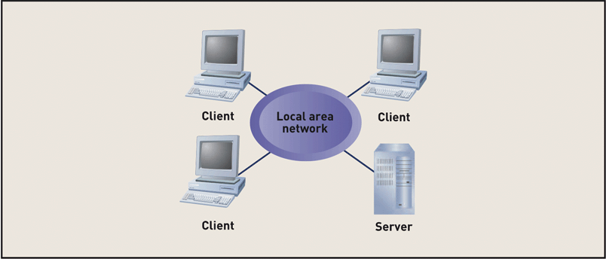
Interaction Among Multiple Clients and a Single Server (Figure 9-11)
Systems Analysis and Design in a Changing World, 4th Edition

Slide 32
Client/Server Architectural Process
Decompose application into client and server programs, modules, or objects
  Identify resources or services that can be centrally managed by independent software units
Determine which clients and servers will execute on which computer systems
Describe communication protocols and networks that connect clients and servers
Systems Analysis and Design in a Changing World, 4th Edition

Slide 33
Three-Layer Client/Server Architecture
Layers can reside on one processor or be distributed to multiple processors
Data layer – manages access to stored data in databases ( interacts with the database)
Business logic layer – implements rules and procedures of business processing
View layer – accepts user input and formats and displays processing results( contains the user interface).
Systems Analysis and Design in a Changing World, 4th Edition

Slide 34
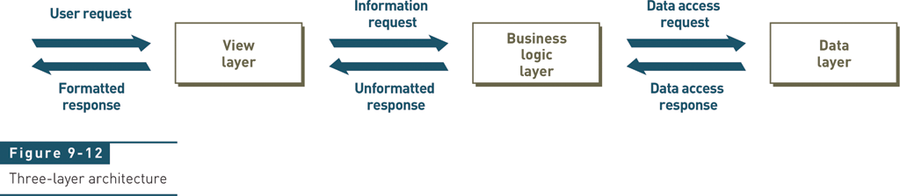
Three-Layer Architecture
Systems Analysis and Design in a Changing World, 4th Edition

Slide 35
Three-Layer Client/Server Architecture (Cont.)
Three-layer architecture: is inherently flexible.
Interactions among the layers are always request-response.
Layers restively independent of one another.
Widely applied with traditional approach and object-oriented approach.
Systems Analysis and Design in a Changing World, 4th Edition

Slide 36
Web Services Architecture
A client/server architecture
Packages software functionality into server processes (“services”)
Makes services available to applications via Web protocols ( XML, Web Services Description Language (WSDL) and UDDI.
Web services are available to internal and external applications
  Developers can assemble an application using existing Web services
Systems Analysis and Design in a Changing World, 4th Edition

Slide 37
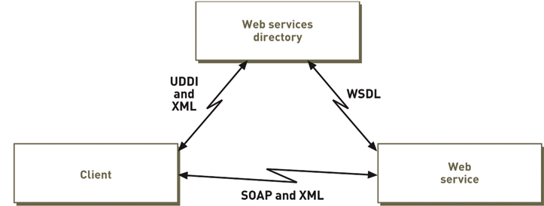
Web Services Architecture (Figure 9-13)
Systems Analysis and Design in a Changing World, 4th Edition

Slide 38
Middleware
Aspect of distributed computing
Connects parts of an application and enables requests and data to pass between them
Transaction process monitors, object request brokers (ORBs), Web services directories
Designers reply on standard frameworks and protocols incorporated into middleware (eg. DBMSs employ standard protocols such as SQL.
Systems Analysis and Design in a Changing World, 4th Edition

Slide 39
Internet and Web-Based Application Architecture
Web is complex example of client/server architecture
Can use Web protocols and browsers as application interfaces
Benefits
  Accessibility
  Low-cost communication
  Widely implemented standards
Systems Analysis and Design in a Changing World, 4th Edition

Slide 40
Negative Aspects of
Internet Application Delivery
Breaches of security
Fluctuating reliability of network throughput
Throughput can be limited
Volatile, changing standards
Systems Analysis and Design in a Changing World, 4th Edition

Slide 41
Network Design
Integrate network needs of new system into existing network infrastructure
Describe processing activity and network connectivity at each system location
Describe communications protocols and middleware that connects layers
Ensure that network capacity is sufficient
  Data size per access type and average
  Peak number of access per minute or hour
Systems Analysis and Design in a Changing World, 4th Edition

Slide 42
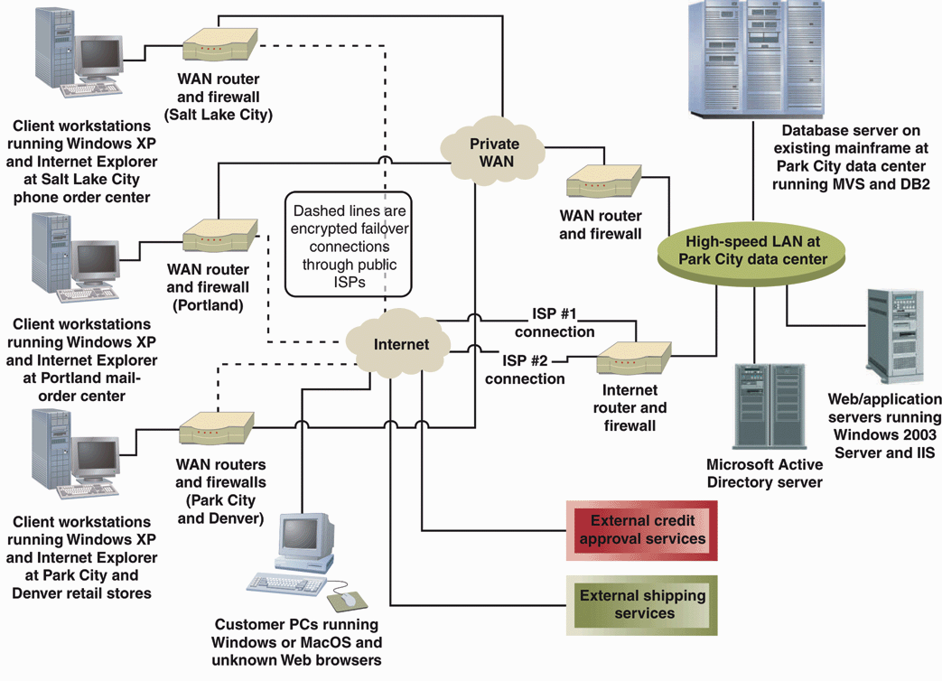
Network Diagram for RMO
Customer Support System (Figure 9-14)
Systems Analysis and Design in a Changing World, 4th Edition

Slide 43
Summary
Systems design is process of organizing and structuring components of system to allow construction (programming) of new system
Design phase of project consists of activities that relate to design of components of new system
  Application architecture, user interfaces, system interfaces, databases, network diagrams, system controls
  Prototyping may be required to specify any part or all of the design
Systems Analysis and Design in a Changing World, 4th Edition

Slide 44
Summary (continued)
Inputs to design activities are diagrams built during analysis
Outputs of design are also diagrams that describe architecture of new system and detailed logic of programming components
Inputs, design activities, and outputs are different depending on whether a structured approach or an object-oriented approach is used
Architectural design adapts to development environment and decomposes design into layers
Systems Analysis and Design in a Changing World, 4th Edition

